Slide 1
Voice Controlled Bot
By Abdurrahmaan Baghdadi

Slide 2

My Story
The way I came to encounter the UTSA Open Cloud Institute for research was through my mom who works at UTSA and helped me get into a program for computer science and cybersecurity under Dr. Paul Rad. Thus, I got the opportunity to work with autonomous vehicles and voice control systems.

Slide 3
The Project

Slide 4
Can an autonomous vehicle and other vehicles connect with a voice controlled system?

Slide 5
The Goal

Slide 6
Our goal was to set up a Alexa voice system to control a car.

Slide 7
Materials
Donkey car website
Alexa
Siri
Voice Control and Motor Control Software

Slide 8

Procedure
First we got the car to respond to computer code by finding the specified data needed.
Then we programmed the car to follow basic commands such as left, right, forward, and backward.
Then we connected the car to the voice system

Slide 9

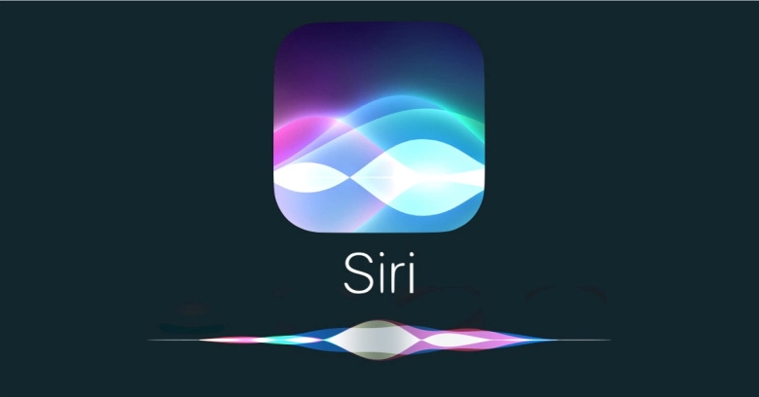
What happened vs. what was planned
We thought we could use Alexa voice system functions in Amazon Web Services (AWS) to control the car.
Instead, we programmed the cars steering and throttle to work along with Siri in order to execute certain commands.

Slide 10
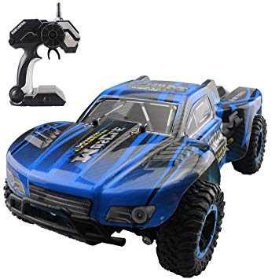
Problems we encountered
The throttle would not respond to PCA9685 control board commands.
We tested this by checking if the throttle commands would work with the remote the car came with.
Then we found that the command PCA9685(Channel) was used to switch between steering and the throttle and fixed the problem
Alexa voice system required an account and other unnecessary things.
We found a way to customize commands in Siri and decided that we could use this to our advantage when working with the car and changed to a Siri controlled system.

Slide 11
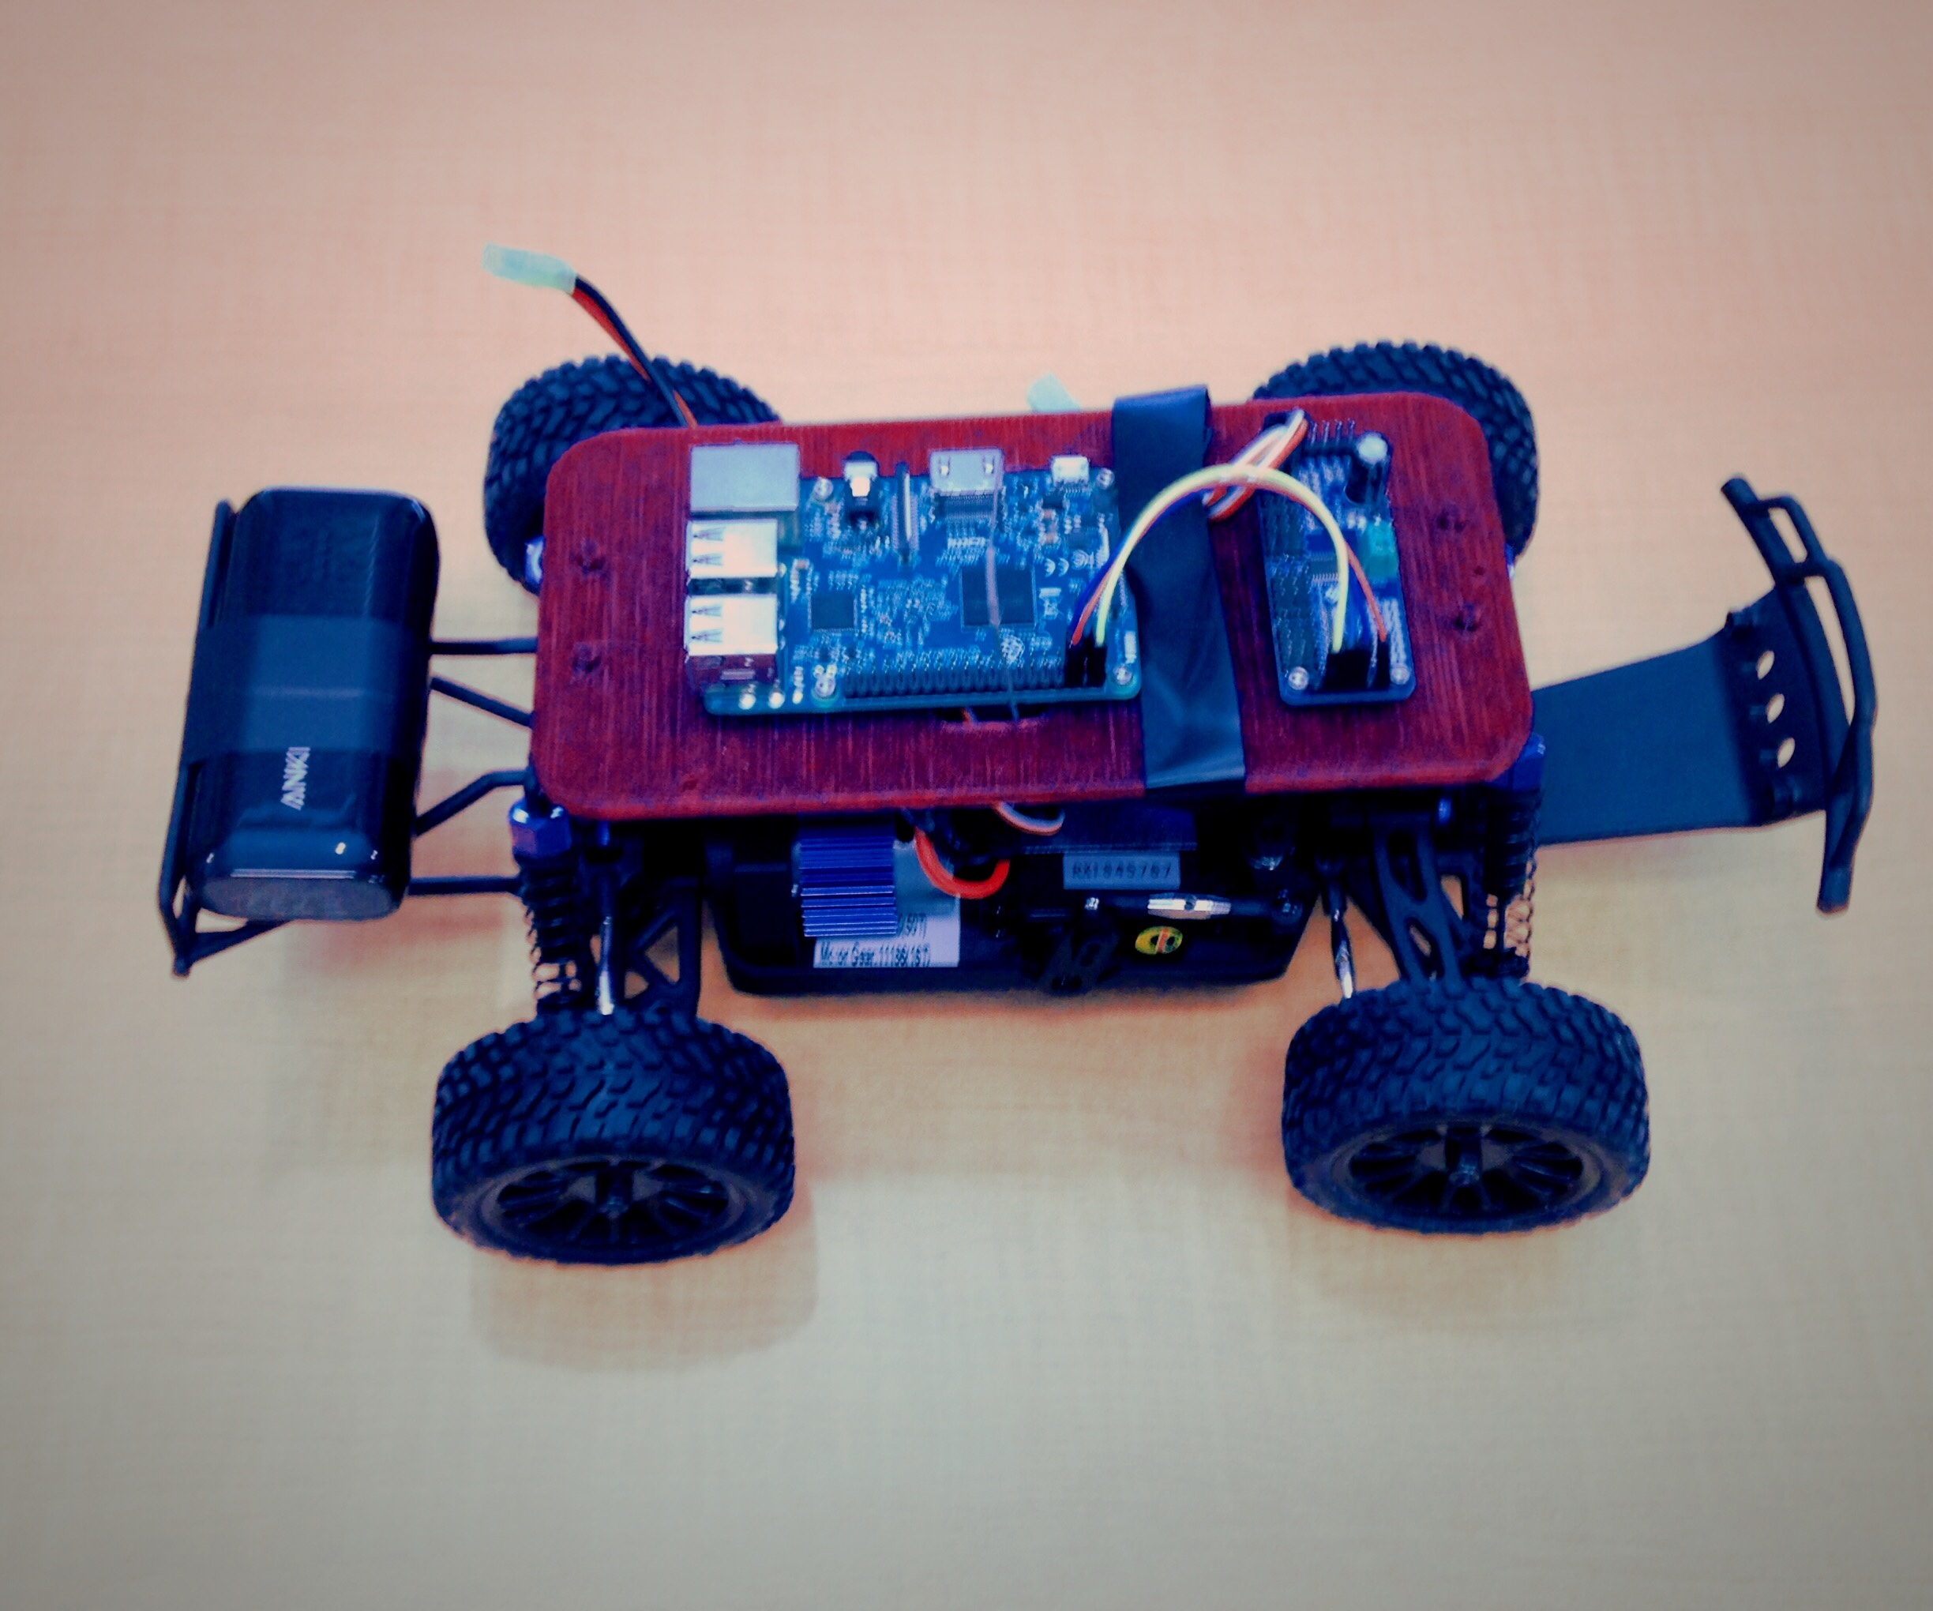
Problems we encountered(cont.)
Some of the code with the modules for the Siri control system didn’t connect with the throttle and steering circuit board.
We fixed this issue by finding a method to bring the code of the steering into the module system.

Slide 12

Sign up for Camps
Network with teachers to get connections
Choose something you like to do
Talk to teachers and parents
Find people who are experienced and can teach you
Advice

Slide 13
CONCLUSION

Slide 14
An Alexa voice system can be used to control a car, but using a Siri voice system was more efficient.

Slide 15
Special Thanks
Garrett Hall for helping me invest in my future and providing me opportunities to make my name
Samuel Silva for allowing me to do all the fun things I have done over summer and helping me with my project
Tommy Kercheville for walking me through the project and helping me along the way
Dr Paul Rad for giving me this opportunity
Everyone at the OCI Lab for all their support and help
The IEEE RAS UTSA Student Chapter for letting me be a part of the team.

